Slide 1
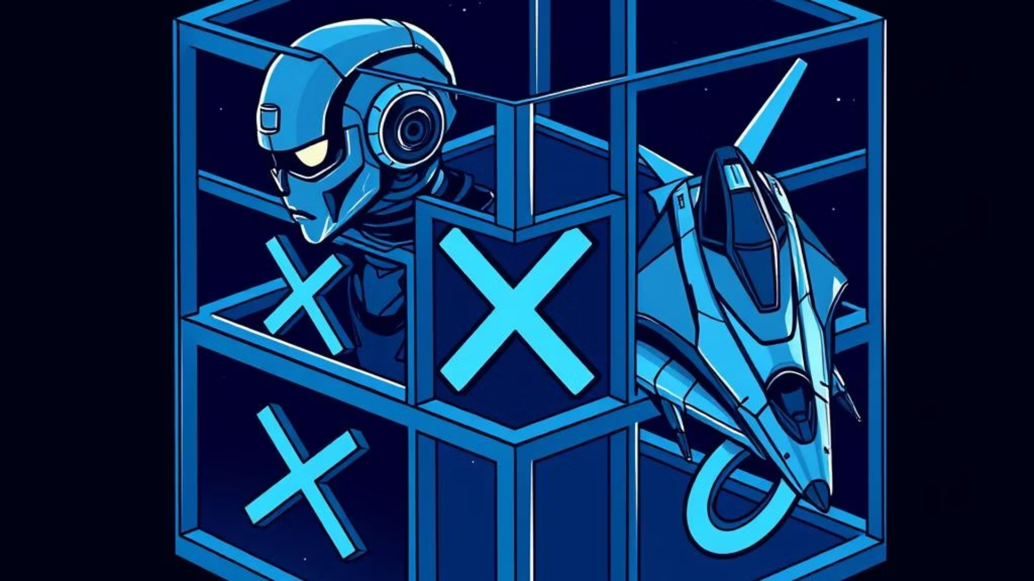
Cubic 4×4×4 tic-tac-toe
Group 24
Name
ID
Group
Amr Ahmed Fawzy
236044
A3/SE
Abdelrahman Salah
229214
A2/AI
Ahmed Maged Elgalaly
231051
A1/CS
Ahmed Zidan
231036
A2/SE

Slide 2
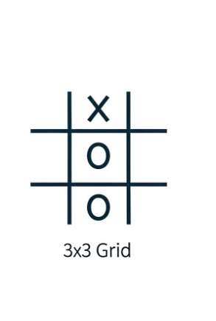
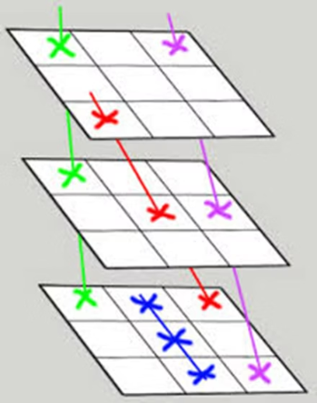

Problem & Objective
Problem
Objective
1
Classic 3×3 tic-tac-toe is trivial
1
Implement efficient game logic to check all winning lines in real time
2
4×4×4 has 76 possible winning lines
2
Build AI using Minimax + Alpha-Beta Pruning for fast, competitive play
3
Detecting a win each move with low time-complexity is hard

Slide 3

Methodology – Algorithms
Minimax search: Explores all possible moves thoroughly.
Alpha-Beta Pruning: Cuts off losing branches for faster decisions.
Heuristics: Positional weight and geometric pattern scoring guide play.
Efficiency: Pruning cuts decision time from 1.65s to 0.62s per move.

Slide 4
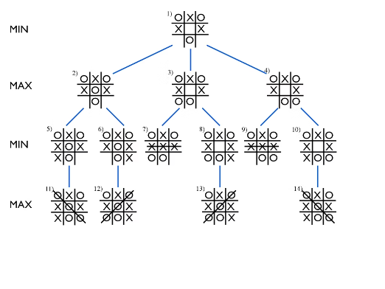
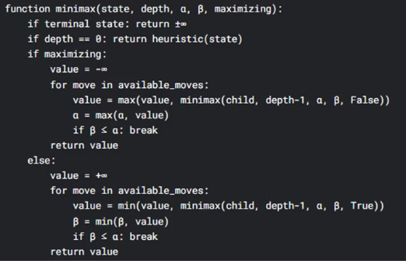
Minimax Algorithm Explained
Minimax is a recursive decision-making algorithm used in game theory.
It assumes both players play optimally—Maximizer aims to maximize the score, while Minimizer tries to minimize it.
The algorithm evaluates game states as a tree, choosing the move that leads to the best guaranteed outcome.

Slide 5
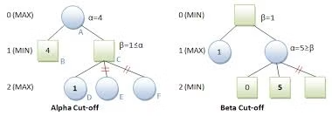
Alpha-Beta Pruning Optimization
Alpha-Beta Pruning reduces nodes evaluated by skipping branches that cannot affect the final result.
It tracks Alpha (best for Maximizer) and Beta (best for Minimizer) to prune branches early.
This optimization speeds up decisions without changing the Minimax outcome or accuracy.

Slide 6
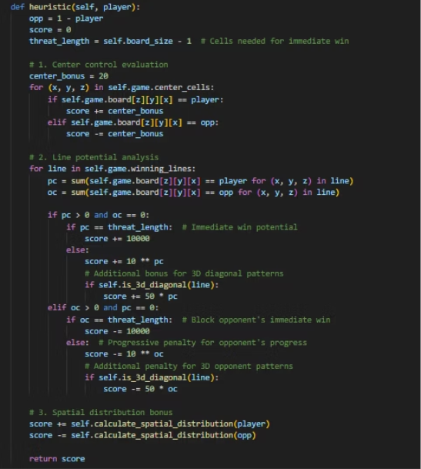
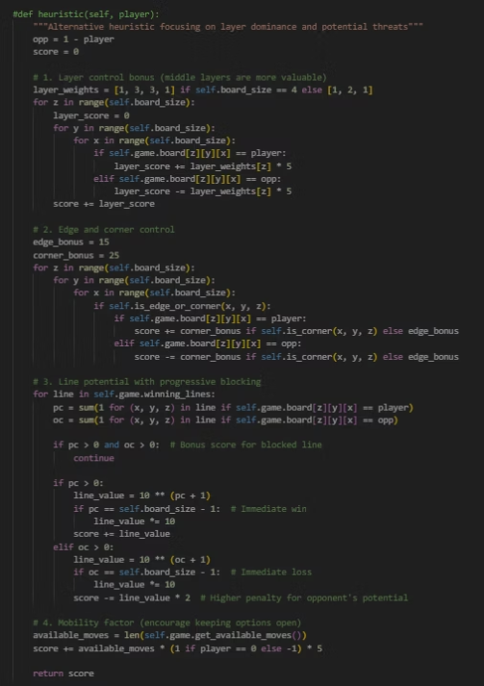
Heuristic Evaluation Functions
Positional Heuristic: Scores moves by strategic location: center > edges > corners.
Geometric Line Heuristic: Scores partial lines of 2 or 3 aligned marks, favoring near wins.

Slide 7
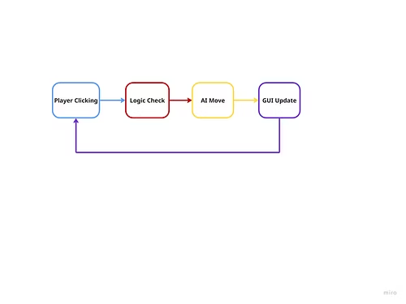
Methodology – System Design
CubicGame class: Manages board state, move validation, winning-line generation
AIPlayer class: Implements Minimax, Alpha-Beta pruning, and heuristics
GameGUI class: Pygame interface rendering 3D grid and handling input
Data flow: Player click → logic check → AI move → GUI update

Slide 8
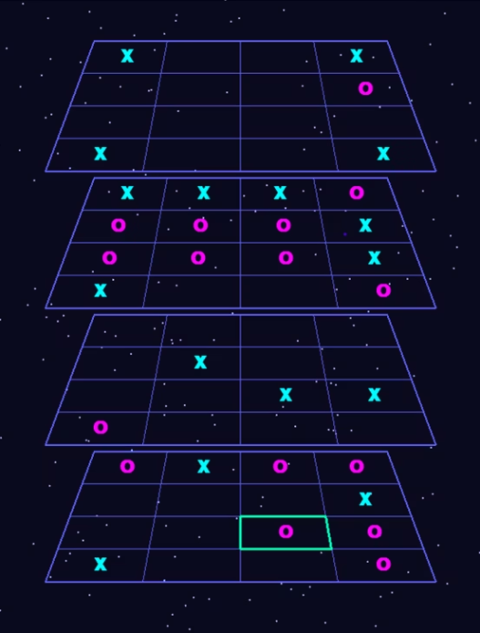
Implementation Highlights
Instant move undo/redo in zero time for smooth gameplay
Precomputed 76 winning lines enable O(1) win checking
Depth-limited Minimax search ensures fast, responsive AI

Slide 9
Evaluation & Testing
Metric
Minimax
Alpha-Beta
Win Rate
0%
0%
Draw Rate
100%
100%
Avg. Move Time (s)
1.65
0.62
Moves per Game
32
32

Slide 10
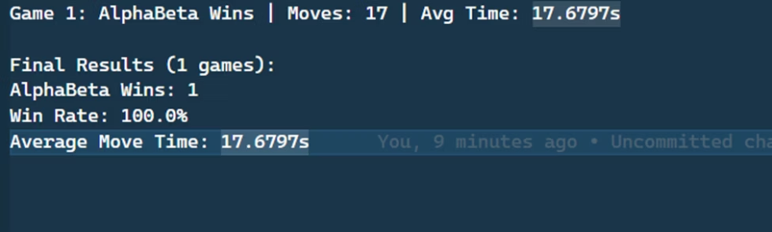
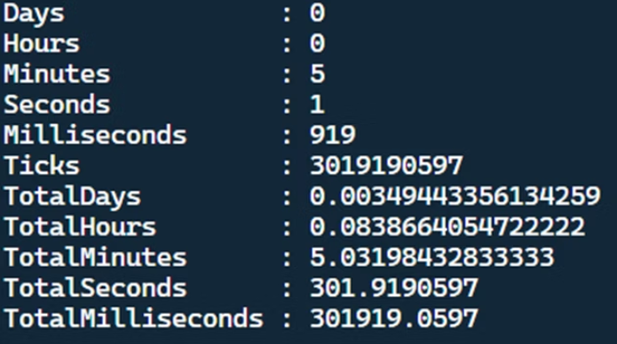
our AI against Alpha-Beta Pruning with only one game with the depth of 4 (for the testing algorithm).
The AI Agent playing against our AI only won once (that we witnesses)
To generate this wining alone it took a single game 5 minutes.

Slide 11
Challenges & Solutions
Challenges
Solutions & Future Work
Branching factor explosion leads to long decision times
Iterative deepening and time control for AI responsiveness
Limited testing depth makes catching edge-case bugs difficult
Expand test suite with randomized deep-play scenarios

Slide 12








Team Contributions
Each member focused on core components for efficient development.
AIPlayer & Heuristics
CubicGame & Winning Lines
Abdelrahman Salah: AI-player
Ahmed Elgalay & Amr Fawzy
Ahmed Zidan & Amr Fawzy:Heuristics
Core logic creating and managing winning line checks.
Designed Minimax with Alpha-Beta pruning and scoring heuristics.
Testing & Evaluation
GUI & Integration
Ahmed Elgalay
All Members
Collaborated on playtesting and performance measurement.
Built interactive Pygame interface and connected game logic.

Slide 13



Thank You!
Ask Anything
Your Feedback
Next Steps
Feel free to clarify any part of the project or our approach.
Helps us improve and tailor solutions better for you.
Open dialogue fosters collaboration and success.

